Slide 1


Theory of Computation
Nonregular Languages
王轩
Wang Xuan

Slide 2
Outline
Non-regular languages
The Pigeonhole Principle
Pumping lemma
Applications of the Pumping Lemma
Notes:
非正则语言
鸽巢原理
泵引理
泵引理的应用

Slide 3
Regular or Nonregular?
  Consider two languages over the alphabet Σ = {0,1}
Non-regular languages
{w| w has equal number of 0s and 1s}
Regular languages
{w| w has equal number of occurrences of 01 and 10 as substrings}

Slide 4
How can we prove that a language L is not regular?
Prove that there is no DFA or NFA or RE that accepts L
Difficulty: this is not easy to prove
(since there is an infinite number of them)
Solution: Use the Pumping Lemma.
Notes:
如何证明一个语言L不是正则的？
证明没有DFA或NFA或正则表达式可以接受语言L
困难：有无穷多的DFA/NFA/RE，不好证明
解决办法：泵引理

Slide 5
The Pigeonhole Principle
Before we learn the Pumping lemma, we should learn the Pigeonhole Principle at first.
Notes:
在介绍泵引理前，先介绍鸽巢原理

Slide 6

The Pigeonhole Principle
4 pigeons
3 pigeonholes
Notes:
鸽巢原理：有四只鸽子要放到3个鸽巢内，至少有一个鸽巢内有超过一只鸽子

Slide 7
The Pigeonhole Principle
If we want to put every pigeon in a pigeonhole.
A pigeonhole must contain at least two pigeons.
Notes:
The Pigeonhole Principle

Slide 8

The Pigeonhole Principle
n pigeons
...........
m pigeonholes
...........
Notes:
推广：n只鸽子放到m个鸽巢内，n>m

Slide 9


The Pigeonhole Principle
pigeons
There is a pigeonhole
with at least 2 pigeons
pigeonholes
...........
Notes:
有一个鸽巢内至少2只鸽子

Slide 10






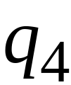


Example
Consider a DFA with states
Notes:
考虑一个4状态DFA

Slide 11



Consider the walk of a “long’’ string: aaaab
(length at least 4)
A state is repeated in the walk of aaaab
Notes:
一个长度为5的输入串aaaab在DFA上的运行，至少有一个状态会重复

Slide 12
The state is repeated as a result of
the pigeonhole principle
Walk of aaaab
Pigeons:
(walk states)
Pigeonholes:
(Automaton states)
Repeated
state
Repeated
state
Notes:
状态会重复是由于鸽巢原理，其中处理字符串时的状态相当于鸽子，总共的状态数相当于鸽巢

Slide 13
Consider the walk of a “long’’ string: aabb
(length at least 4)
Due to the pigeonhole principle:
A state is repeated in the walk of aabb
Notes:
考虑输入串aabb,有一个状态会重复出现

Slide 14
The state is repeated as a result of
the pigeonhole principle:
Walk of aabb
Pigeons:
(walk states)
Pigeonholes :
(Automaton states)
Automaton States
Repeated
state

Slide 15
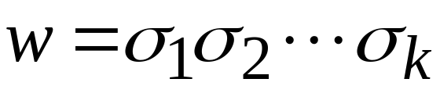












In General:
If|w|≥ the number of states of DFA, by the pigeonhole principle, a state is repeated in the walk w
Walk of
....
....
....
Arbitrary DFA
......
......
Repeated state
Notes:
Arbitrary任意的
对一个DFA，若输入串长度大于等于DFA的状态数，根据鸽巢原理，至少有一个状态会重复出现

Slide 16


Let m be the number of states of DFA, |w|≥ m
Number of states in walk is at least m+1
Pigeons:
(walk states)
Walk of w
....
....
....
....
....
Pigeonholes:
(Automaton states)
A state is repeated

Slide 17


Pumping Lemma
Take an infinite regular language
(contains an infinite number of strings)
There exists a DFA that accepts
m states
Notes:
泵引理
有一个无限长的正则语言L（包含无限长串），存在一个接受该语言L的DFA，有m个状态

Slide 18

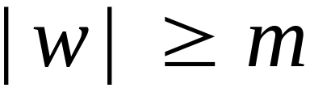

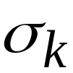

Take string with
(m is the number
of states of DFA)
then, at least one state is repeated
in the walk of
Walk in DFA of
......
......
Repeated state in DFA
Notes:
语言L中的串w，长度超过状态数m，那么至少有一个状态重复出现

Slide 19

There could be many states repeated
Take to be the first state repeated
One dimensional projection of walk :
First
occurrence
Second
occurrence
....
....
....
Unique states
Notes:
重复状态可能不止一个。假设q是第一个重复状态。q出现的第一个地方和第二个地方。
One dimensional projection 一维投影

Slide 20


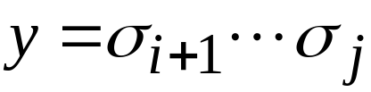
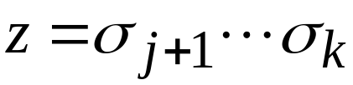
We can write
One dimensional projection of walk :
First
occurrence
Second
occurrence
....
....
....
x is the substring before the two q.
z is the substring of the other parts.
y is the substring between the two q.
Notes:
把串w重写成xyz，分为3个子串，子串x是在第一个重复状态q之前的一段，子串y是重复的两个q之间的一段，子串z是第二个重复状态q之后的一段

Slide 21





In DFA:
Where corresponds to substring
between first and second occurrence of
...
...
...
...
Notes:
在w=xyz对应的DFA的walk中，子串y对应的部分有相同的开始和结束状态q

Slide 22

Observation:
Length |xy|≤m
m is the number of states of DFA
...
Because of
unique states in
...
Since, in no
state is repeated
(except q)
Notes:
由于q是第一个重复状态，在xy里面没有重复的状态，那么串xy包含的状态最多有m+1个，而m+1个状态可表示的串为m个字符长度

Slide 23

Observation:
length
Since there is at least one transition in loop
...
Notes:
子串y的长度大于等于1，因为至少有一个转换

Slide 24
We do not care about the form of string
may actually overlap with the paths of and
...
...

Slide 25

Additional string:
The string
is accepted
Do not follow loop
...
...
...
...

Slide 26

Additional string:
The string
is accepted
Follow loop
2 times
...
...
...
...

Slide 27

Additional string:
The string
is accepted
Follow loop
3 times
...
...
...
...

Slide 28
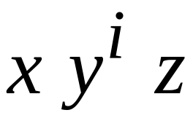


In General:
The string
is accepted
Follow loop
times
...
...
...
...

Slide 29
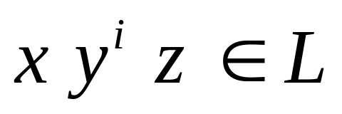
Therefore:
Language accepted by the DFA
...
...
...
...

Slide 30



The Pumping Lemma:
Given a infinite regular language
there exists an integer
(critical length)
for any string with length
we can write
with and
such that:

Slide 31
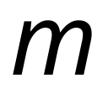
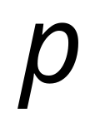
In our textbook:
Critical length = Pumping length

Slide 32
Application
Observation:
Every language of finite size has to be regular
(we can easily construct an NFA
that accepts every string in the language)
Therefore, every non-regular language
has to be of infinite size
(contains an infinite number of strings)

Slide 33

Suppose you want to prove that
an infinite language is not regular
1. Assume the opposite: is regular
2. The pumping lemma should hold for
3. Use the pumping lemma to obtain a
contradiction
4. Therefore, is not regular

Slide 34


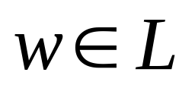
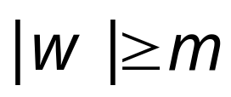
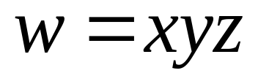
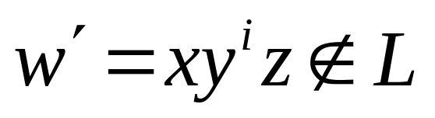
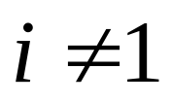
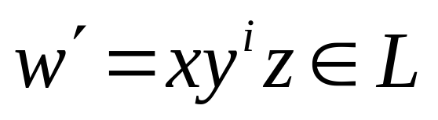
Explanation of Step 3: How to get a contradiction
1. Let be the critical length for
2. Choose a particular string which satisfies
the length condition
3. Write
4. Show that
for some
5. This gives a contradiction, since from
pumping lemma

Slide 35

Example of Pumping Lemma application
Theorem:
The language
is not regular
Proof:
Use the Pumping Lemma

Slide 36
Assume for contradiction
that is a regular language
Since is infinite
we can apply the Pumping Lemma

Slide 37


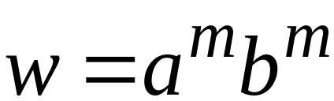
Let be the critical length for
Pick a string such that:
and length
We pick

Slide 38
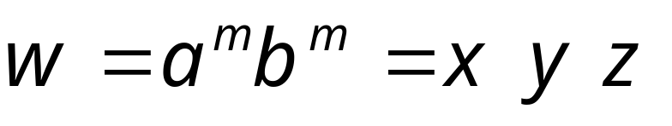

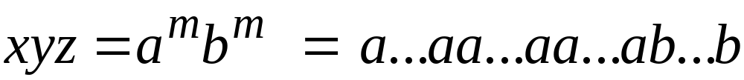

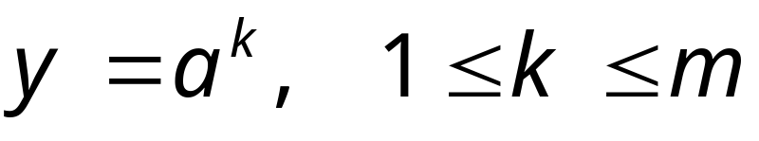
From the Pumping Lemma:
we can write
with lengths
Thus:

Slide 39

From the Pumping Lemma:
Thus:

Slide 40
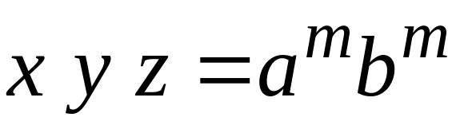

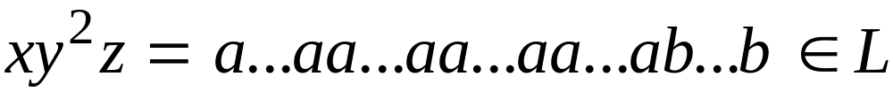
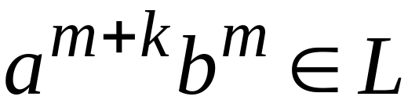
Thus:

Slide 41
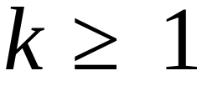
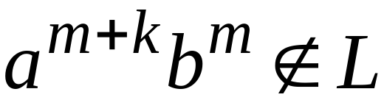
We get that
BUT:
CONTRADICTION!!!

Slide 42
Therefore:
Our assumption that
is a regular language is not true
Conclusion:
is not a regular language
END OF PROOF

Slide 43
Review
Non-regular languages
The Pigeonhole Principle
Pumping lemma
Applications of the Pumping Lemma

